Slide 1
Brokerage Name
Pre Listing Presentation

Slide 2
Jane Realtor
Licensed Real Estate Agent
YEARS OF EXPERIENCE
PRE LISTING PRESENTATION
Share your information here - how many years of experience do you have? How many homes in the area have you sold?
SPECIALTIES
What are your specialties and strengths? What are you looking to bring to the partnership? How do you want your clients to feel when they sell a home with you?

Slide 3
The Sales Process
01
02
Share the steps of your home sale process so your clients understand how this will work.
Share the steps of your home sale process so your clients understand how this will work.
03
04
05
REAL ESTATE SALES PROCESS
Share the steps of your home sale process so your clients understand how this will work.
Share the steps of your home sale process so your clients understand how this will work.
Share the steps of your home sale process so your clients understand how this will work.

Slide 4
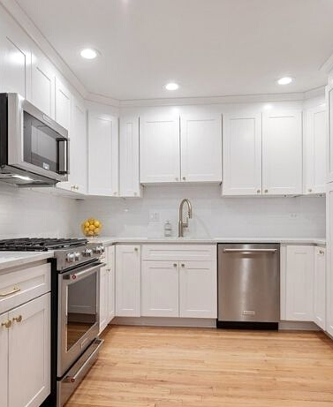
Recent Listing
LOCATION
City, State
RECENT LISTING SHOWCASE
LIST PRICE
What was the home listed for?
PROPERTY SIZE AND CONDITION
How big was it? What shape was it in? Explain one of your recent listings, what went well, and what you did to make it a success, and is there anything you'd do differently this time around?
SALE PRICE
What did the home end up selling for?

Slide 5
Benefits of Pre-Listing Updates
01
ATTRACT MORE BUYERS
80% of Americans say they prefer to buy a move-in ready home over one that requires any updating.
02
SELL YOUR HOME FASTER
Homes updated by our pre listing home improvement partner Curbio sell 50% faster than homes sold as-is.
03
MAXIMIZE SALE PRICE
Curbio achieves a 113% ROI on home improvement costs, meaning if you put $10k into updates to sell, we’ll be aiming to increase your sale price by $21,300.

Slide 6
About Curbio
The pre-listing home improvement experts
Curbio is the pre-sale home improvement company that helps you make significantly more money on the sale of your home, without the hassle or upfront costs of working with a traditional home improvement company.
With help from Curbio, we’ll transform your property into the move-in-ready listing buyers are looking for so that we can sell for top dollar—and you don’t pay for the work until closing!

Slide 7
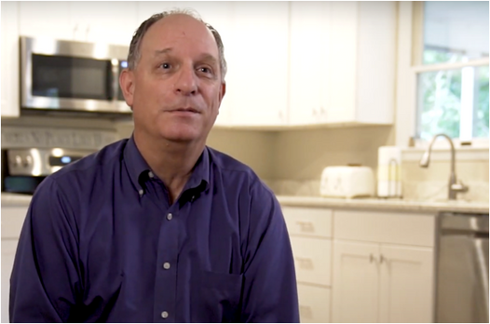
Client Testimonials
PRE LISTING PRESENTATION
Miquel Carter
Dave Compare
REALTOR®
SELLER
"With Curbio, being able to have a budget, stick to it, and finish on time—that is beyond valuable."
"We were kind of stuck. We knew that we wanted to move, but we didn’t have the capital to get the house in the condition that it needed to be in order to be sold."

Slide 8
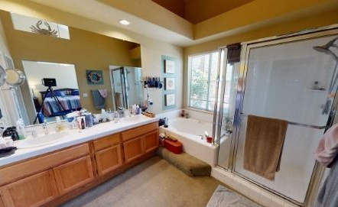
REFRESH
A lot of homes only need a quick refresh to get market-ready. For a refresh, we’ll consider:
•Painting
•Flooring
•Repairs
•New countertops
•Painting cabinets
•Landscaping
…and anything else that doesn’t require permits
TYPES OF CURBIO PROJECTS - REFRESH

Slide 9
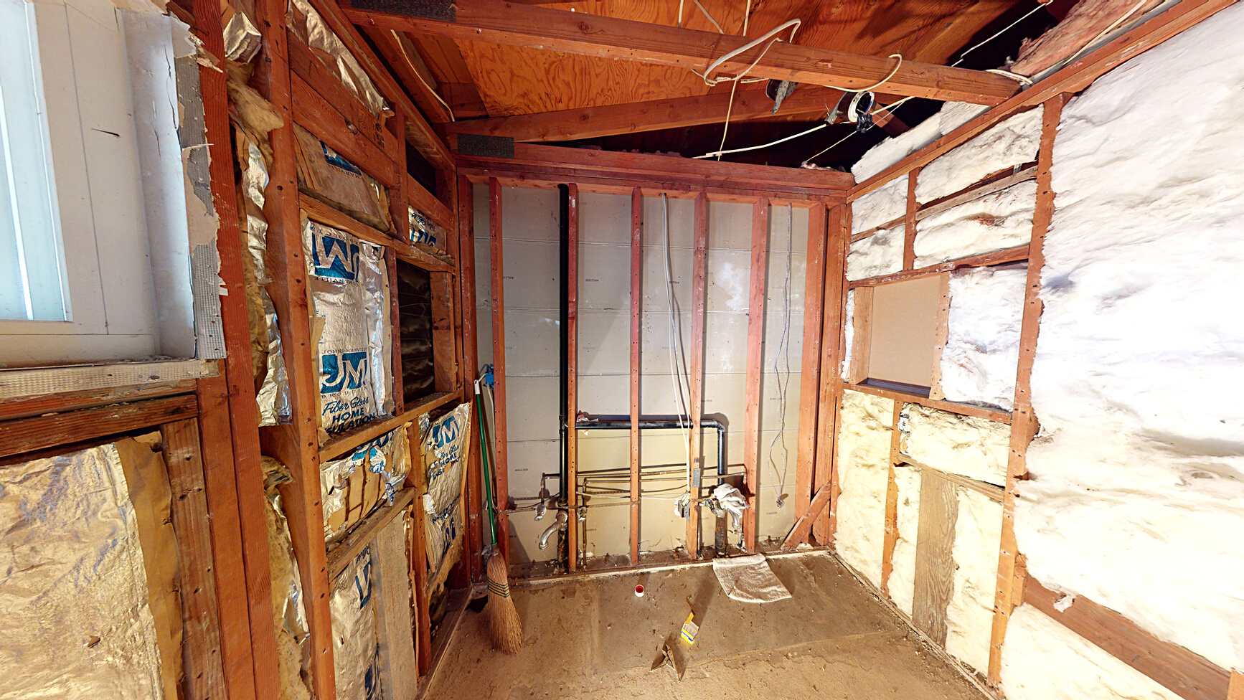
RENOVATION
Curbio can handle any project big or small and can take on any work that isn’t structural. Some renovation items might include:
•Kitchen remodels
•Bathroom remodels
•Bathroom additions
•Roofing
•Plumbing and electric
…and so much more!
TYPES OF CURBIO PROJECTS - RENOVATION

Slide 10
Our Listing
LOCATION
City, State
SELLERS' LISTING
AS-IS SALE PRICE
What would the home sell for in current condition?
PROPERTY SIZE AND CONDITION
How big is it? What shape is it in? What work does it need? How can Curbio help?
ARV PRICE
What could it be listed for (ballpark) after renovations?

Slide 11
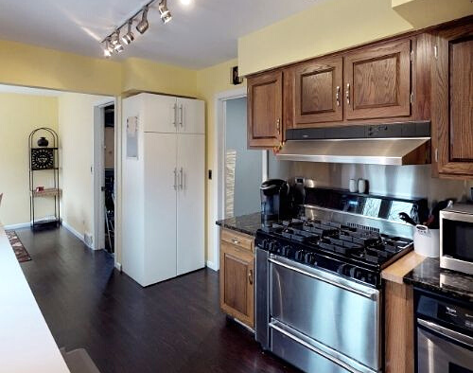
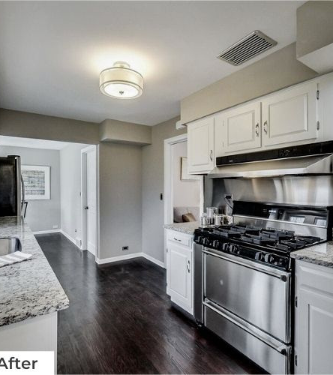
BENEFITS OF PRE LISTING HOME IMPROVEMENT
EXPLAIN BENEFITS OF PRE LISTING HOME IMPROVEMENT
Help your sellers understand their ability to profit more from pre listing refreshes and updates. Remember that Curbio stands for "curb appeal inside and out"—use us for projects inside and outside the home!

Slide 12
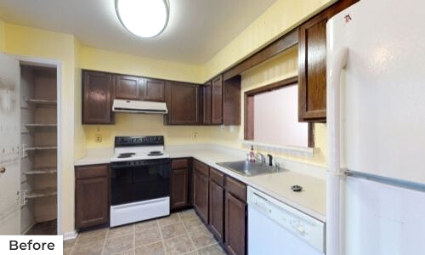
USE THIS PAGE IF NEEDED TO CONTINUE PRE LISTING IMPROVEMENT CONVERSATION
BENEFTIS OF PRE LISTING HOME IMPROVEMENT
Emphasize ease of working with Curbio -- onside project manager, curated materials, streamlined communication with project manager, deferred costs until closing, etc.

Slide 13
Moving Forward
SHARE INFORMATION YOU RECEIVED FROM YOUR CURBIO GENERAL ESTIMATE REQUEST HERE
PRE LISTING PRESENTATION
Discuss project timeline and next steps

